Slide 1
Candidate Briefing Pack
Coast2Bay Housing Group
4 November 2025

Slide 2
About Coast2Bay – Vision and Mission
Vision
Mission

Slide 3
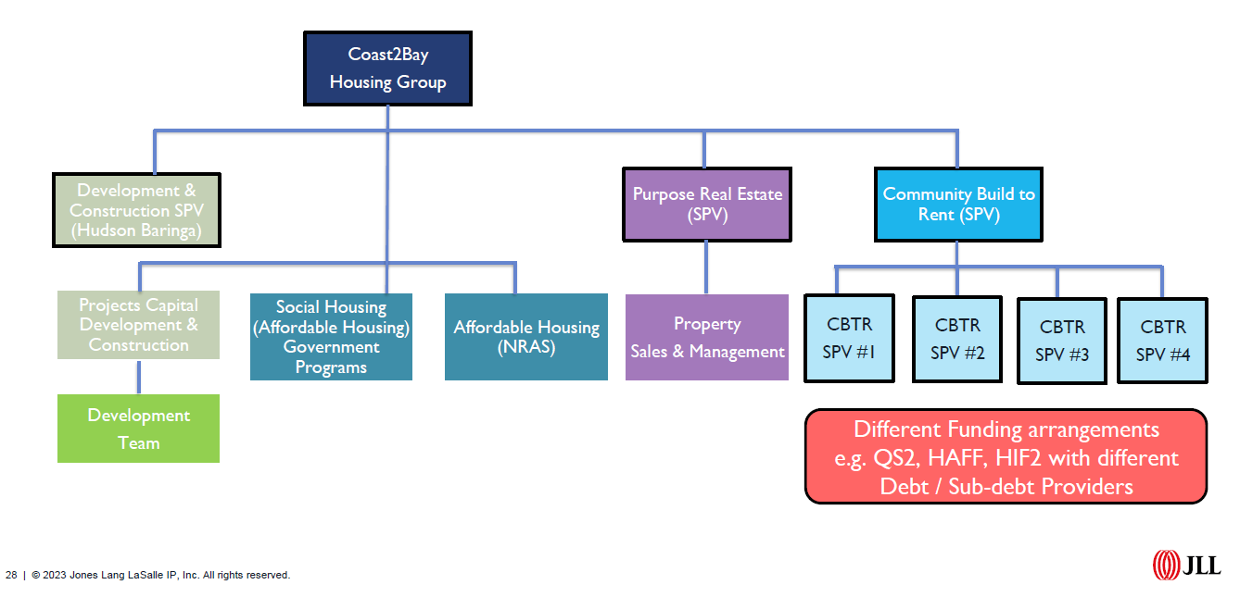
Coast2Bay HOUSING GROUP STRUCTURES

Slide 4
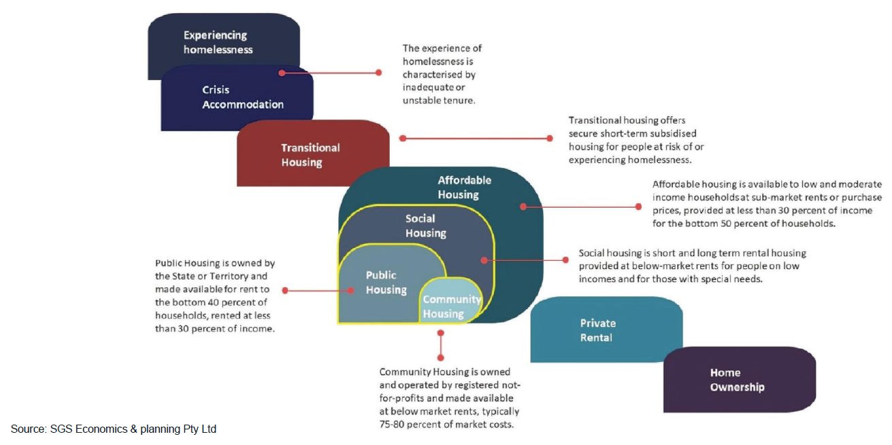
Why WE do WHT WE DO (1)
Community and Affordable Housing - - key linkages

Slide 5
What we do (2)
What is community housing?
Community housing providers (CHPs) are not-for-profits that re-invest surplus revenue into new housing, better services or improving our properties – not into dividends for shareholders. We operate a variety of housing types across the spectrum of need.
Crisis Accommodation
Transitional Housing
Community Housing
Affordable Housing
Private Rental
Home Ownership
Social Housing is for people on very low incomes who can’t find suitable accommodation in the private rental market. It provides homes for some of the most vulnerable in the community, including very specific needs such as escaping DFV, homelessness and people with disability. Rent is usually 25-30% of income.
Affordable Housing is usually defined as housing that is rented at a lower than market rate, often specifically for essential or key workers who have low to medium income levels. Rent is typically 75% of market and should be no more than 30% of household income.

Slide 6
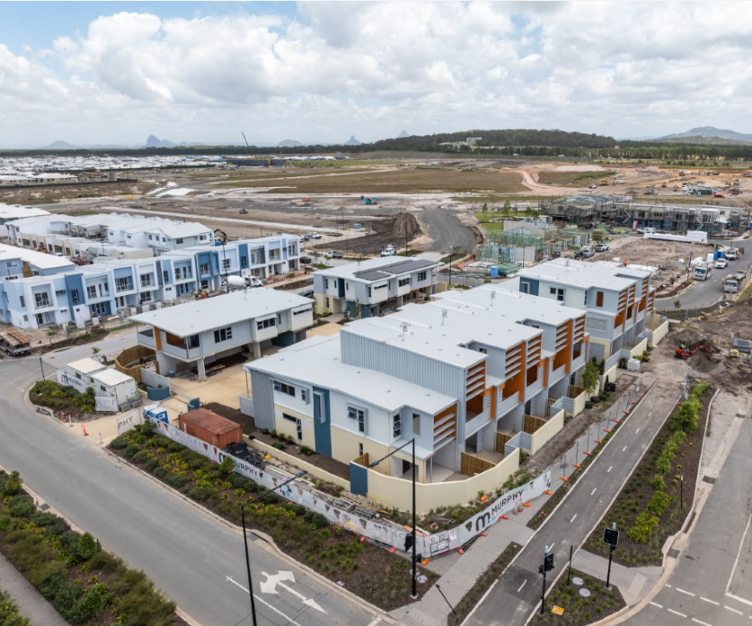
Aspley crescent, nirimba
Project Stats & Facts
24 DWELLINGS | 100% SOCIAL HOUSING
$12.7m TOTAL COST | 42 EST. RESIDENTS
Product Mix | 8 x 1-bedroom units (all LHA Gold) 14 x 2-bedroom units (x12 LHA Silver and x2 LHA Gold) 2 x 3-bedroom units (both LHA Silver)
Funding | Capital grant – Qld Government Department of Housing (QHIGI QuickStarts) No operational funding – rent collected is used to cover costs
Target Cohort/s | • Women over 55 • People living with disability • Seniors
Key Dates | Development Approval Builder appointed Construction commenced Practical completion | October 2022 May 2023 November 2023 November 2024
Builder | Murphy Builders
Key Consultants | Architect Civil & Structural Engineer Landscape Architect Project Manager | Hollindale Mainwaring Architecture Tonkin Project Urban Acceler

Slide 7
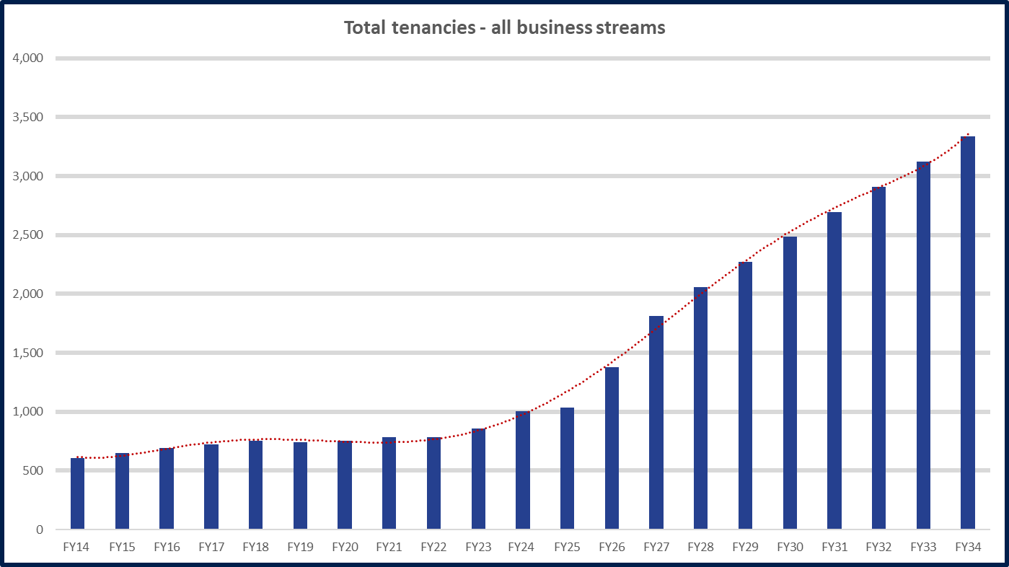
Strategic growth plan – Tenancy Growth
Planned Growth and Development Pipeline & Stretch Targets
E
D
C
A
B

Slide 8
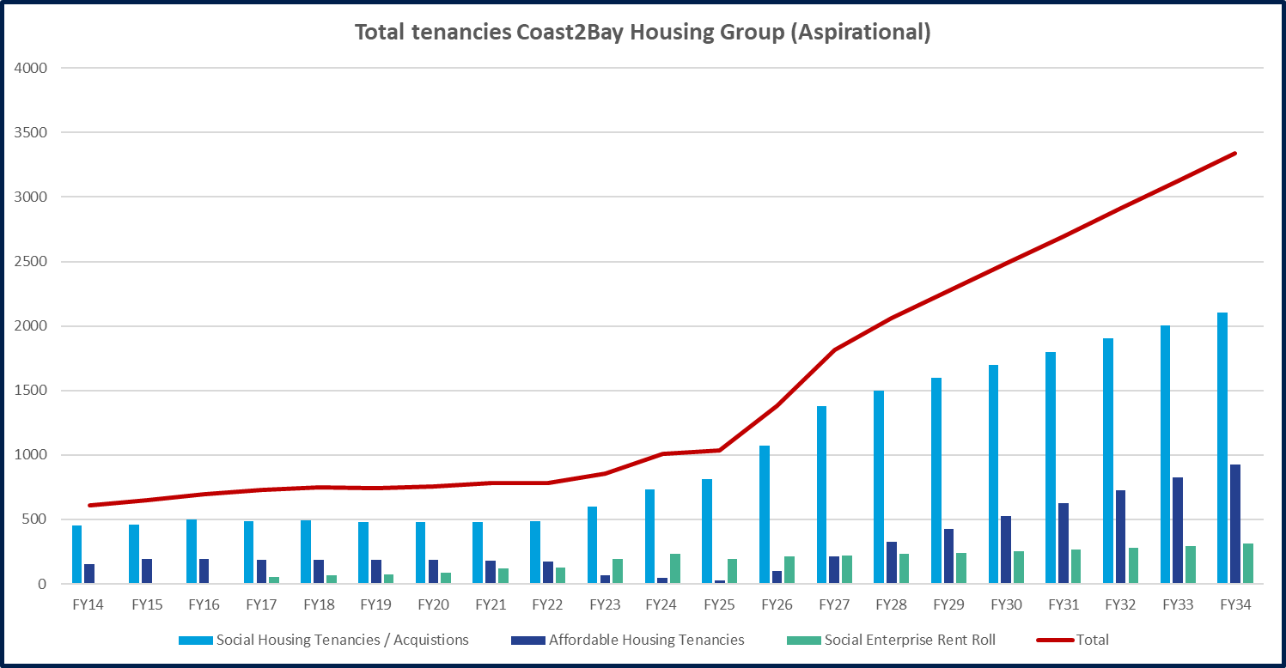
Strategic growth plan – BUSINESS STREAMS GROWTH
Planned Growth and Development Pipeline & Stretch Target
E
D
C
A
B

Slide 9
Growth Channels – 10 Years
A. New community housing tenancies (new leases through Government management transfers, new LTH, stock transfers, dwelling acquisitions / spot purchases)
B. Direct development and construction activity (owned and managed)
C. Indirect development and construction activity on a fee for service basis (managed only e.g. ICHO projects)
D. Direct and or indirect development and construction activity for specialist demographic groups with third parties such as faith-based groups or LGA’s (i.e. DFV, Youth and Veterans)
E. Commercially based joint venture projects for social or affordable housing
F. Third party investment led housing projects (management and operating role only)
G. Merger and Acquisitions
7 Growth Channels

Slide 10
Four Business Activities / Streams
Community Housing
Transitional housing
Affordable Housing
New affordable housing models (eligibility)
Special Projects and Philanthropic Investment
Development and Construction Activity
Current pipeline
Long term housing
Purpose Real Estate (delivery)
Key worker housing
Future pipeline
Rise Foundation and project
Better Together Housing
Housing for specific demographic groups
Partnership work
Specialist housing (disability)
Crisis accommodation
Community managed studio units
COO
COO
COO
EX Manager Development

Slide 11
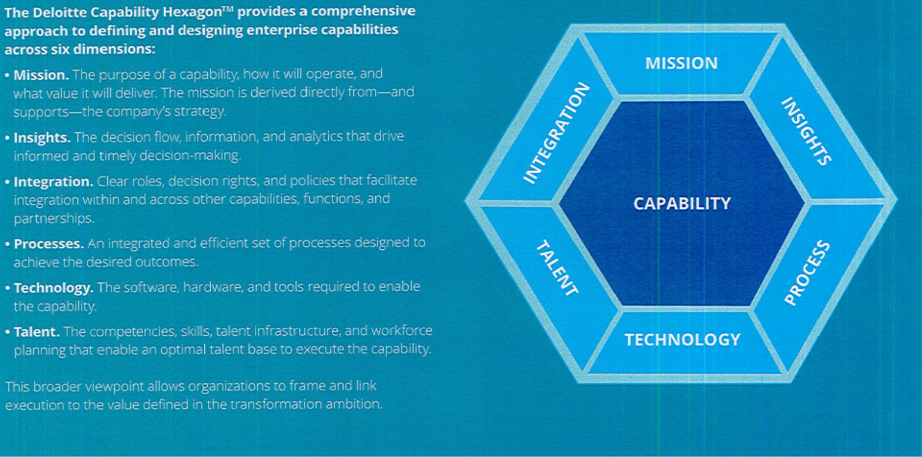
BUSINESS TRANSFORMATION

Slide 12
Thank you
Disclaimer: This presentation has been prepared for general information and engagement purposes for the audience identified on the first slide or cover page only. This document must not be provided to any third party without the written consent of Coast2Bay Housing Group. The information contained in this presentation is current as of the date of the presentation only and must be not relied upon or used for any purpose other than that expressly identified by Coast2Bay.

